Slide 1
Algorithms

Slide 2
Example – 2 dimension maxima

Slide 3
Random Access Machine
(RAM)

Slide 4
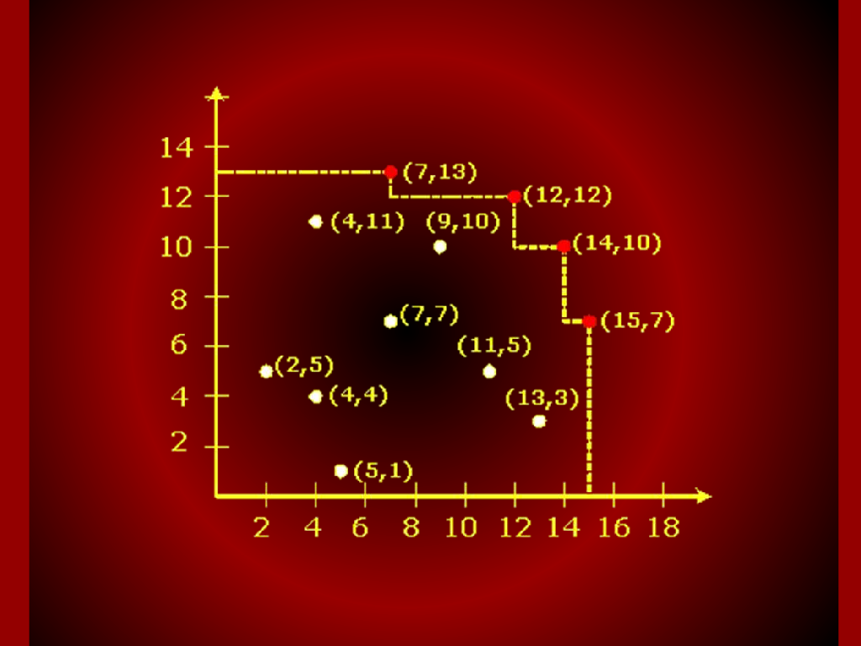
Graph

Slide 5
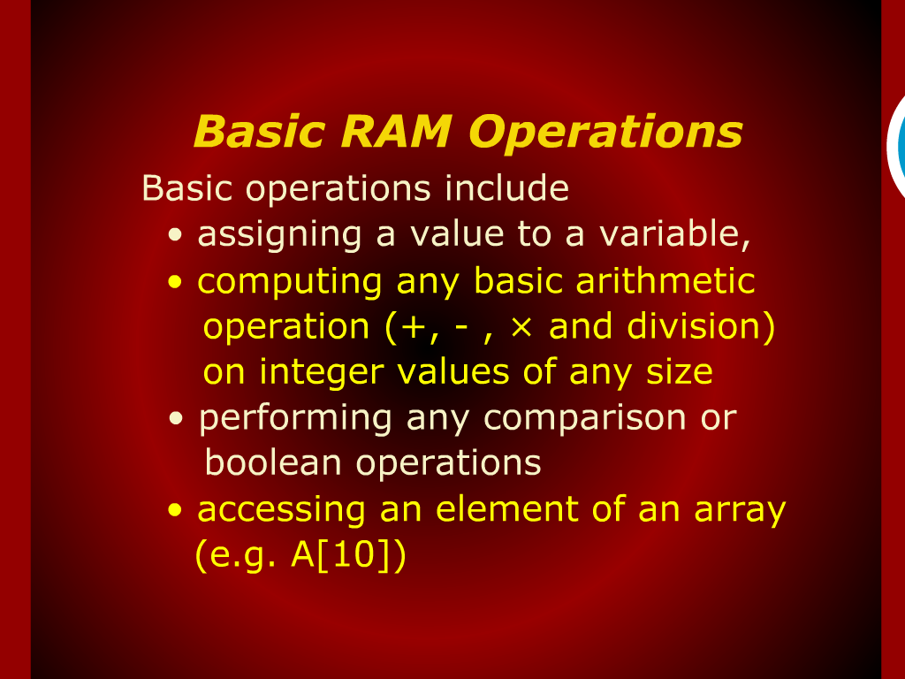
Basic RAM Operations

Slide 6
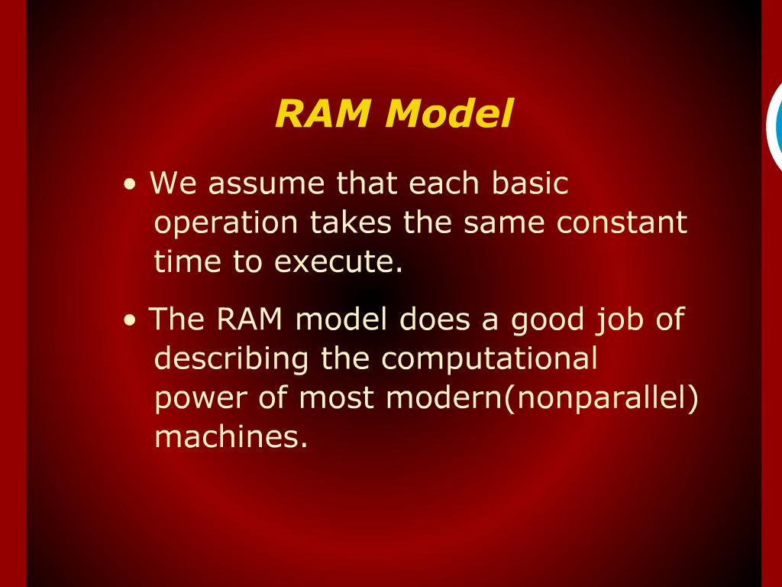
RAM Model

Slide 7
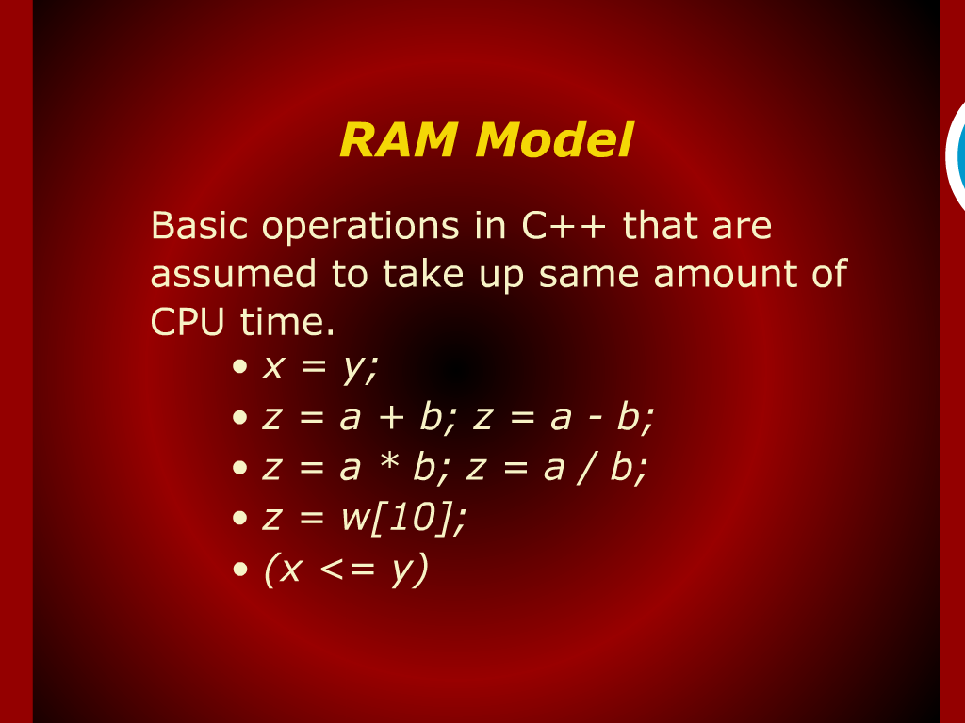
RAM Model

Slide 8
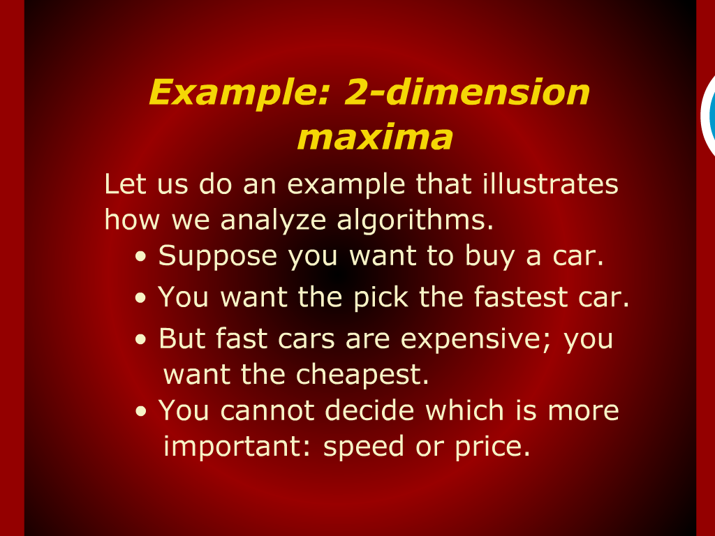
Example: 2-dimension maxima

Slide 9
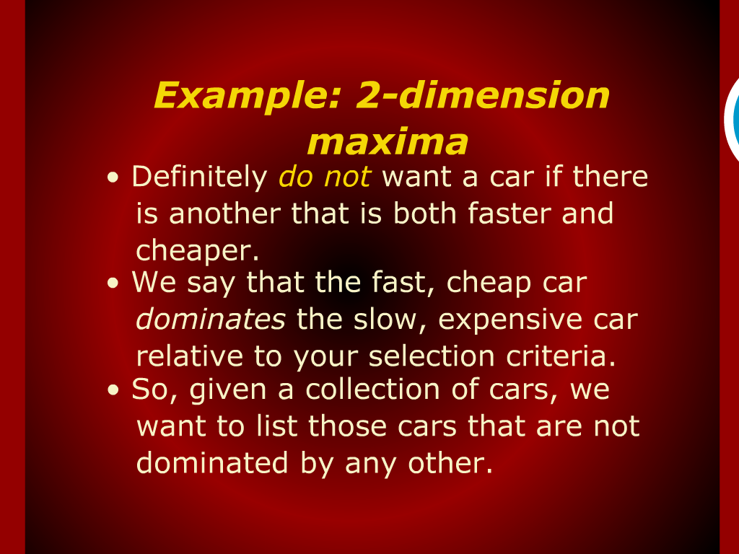
Example: 2-dimension maxima

Slide 10
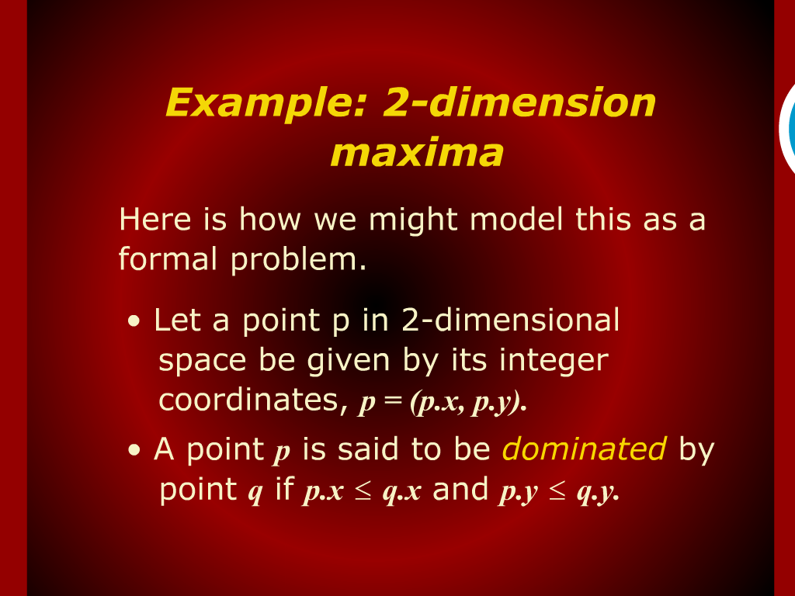
Example: 2-dimension maxima

Slide 11
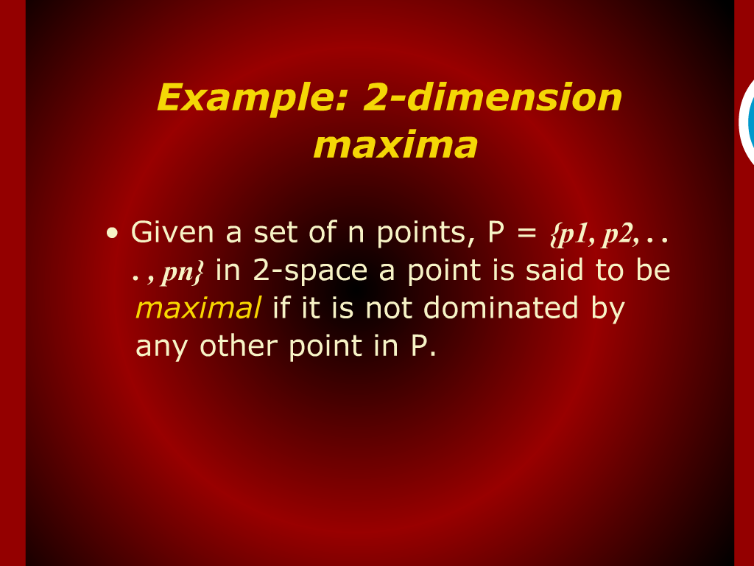
Example: 2-dimension maxima

Slide 12
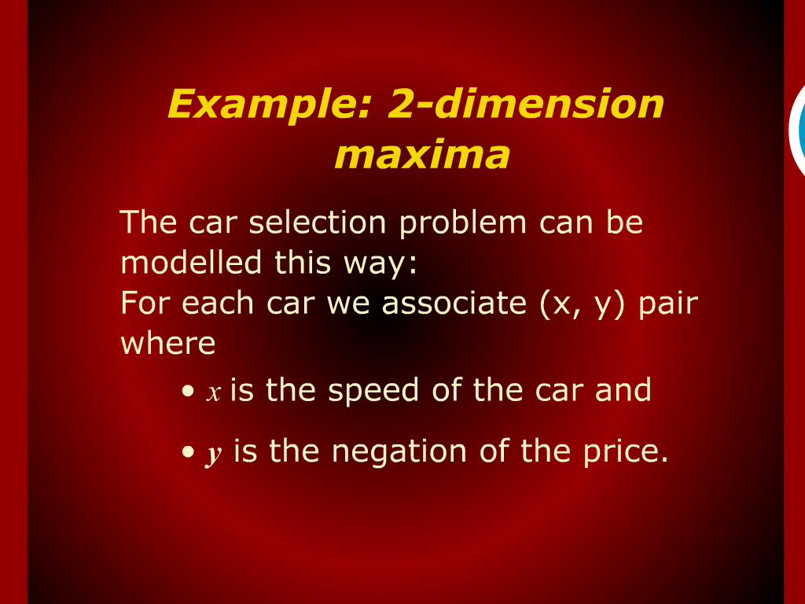
Example: 2-dimension maxima

Slide 13
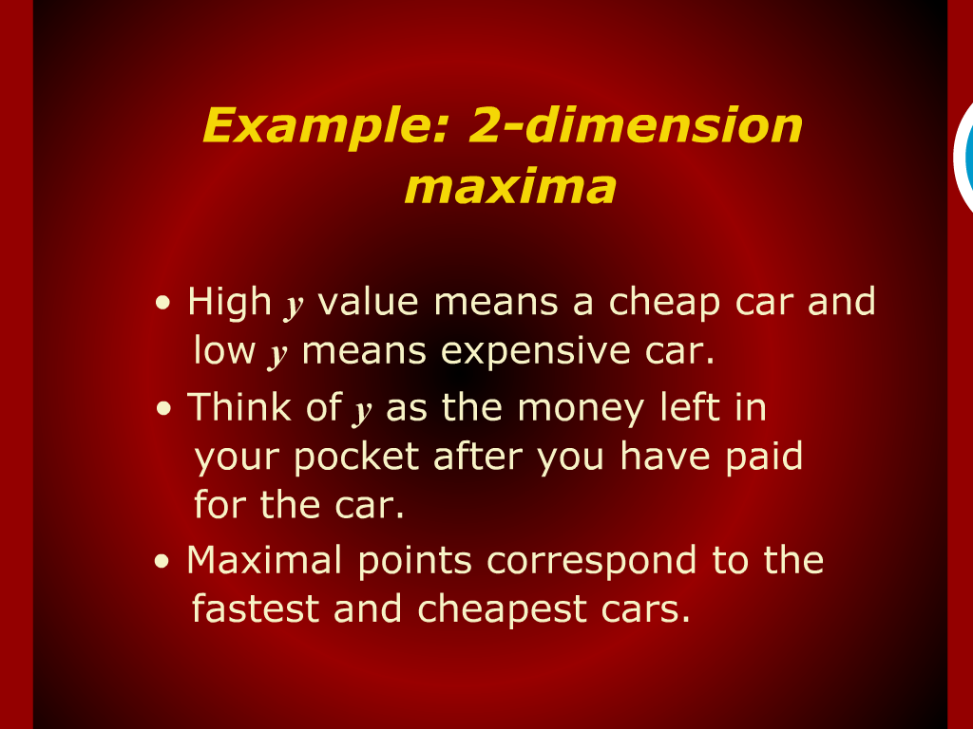
Example: 2-dimension maxima

Slide 14
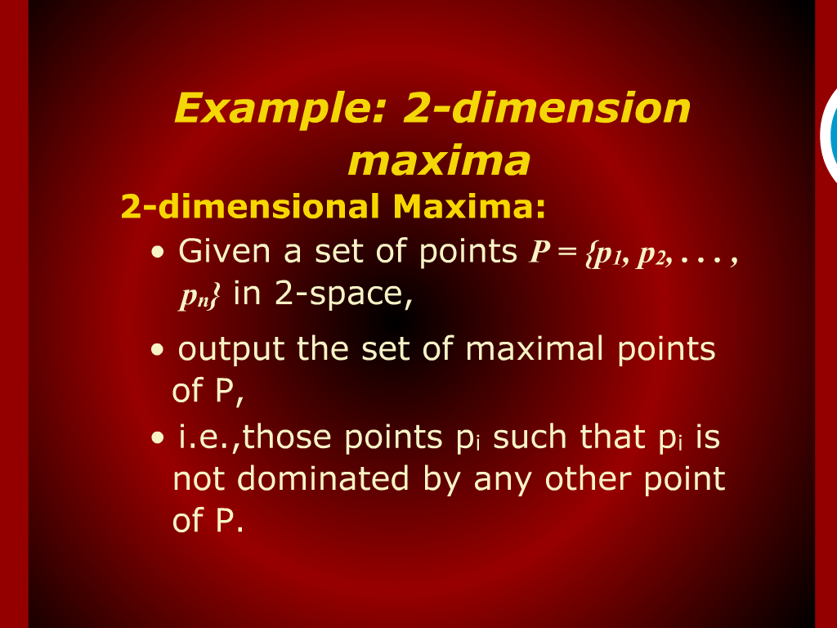
Example: 2-dimension maxima

Slide 15
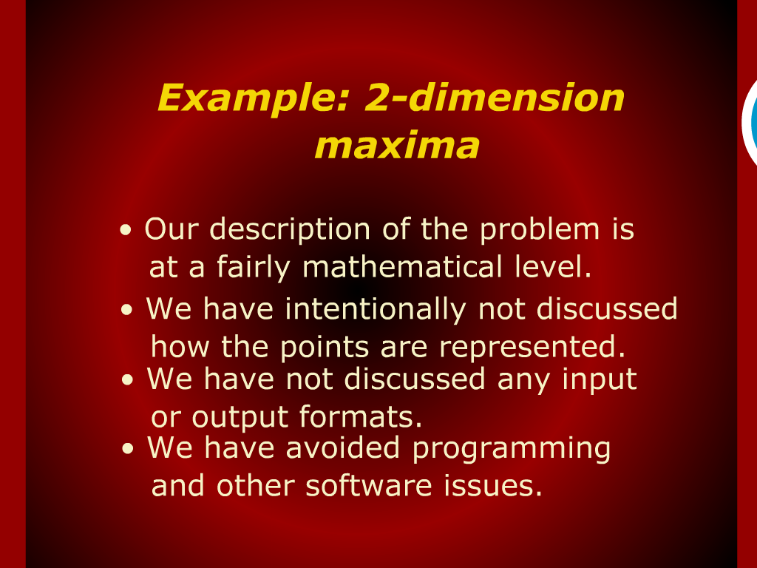
Example: 2-dimension maxima

Slide 16
Example: 2-dimension maxima

Slide 17
Example: 2-dimension maxima

Slide 18
Example: 2-dimension maxima

Slide 19

Example: 2-dimension maxima

Slide 20
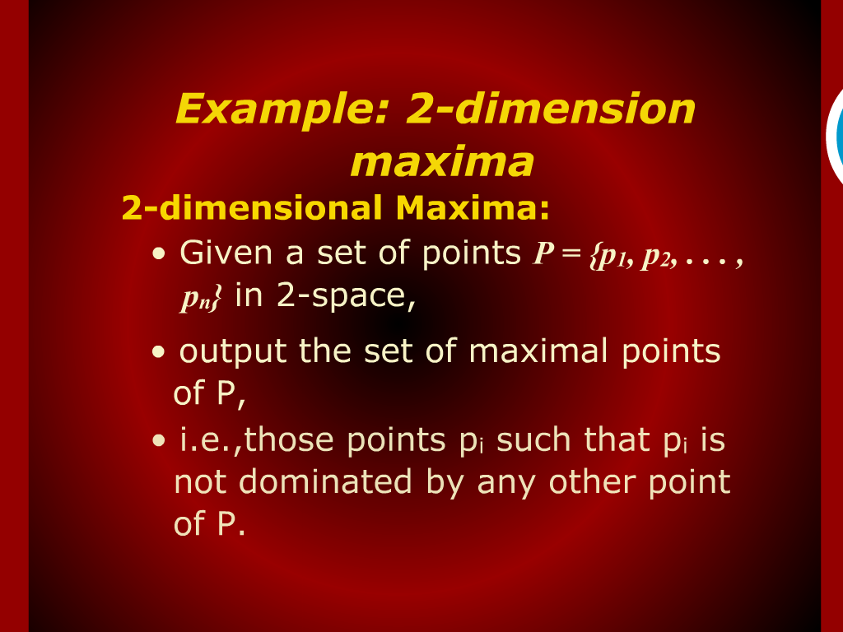
Example: 2-dimension maxima

Slide 21

Example: 2-dimension maxima

